Slide 1
Academic Program Review at SSU
Office of Academic Programs
Division of Academic Affairs
Fall 2025

Slide 2
Why SSU Conducts Program Reviews
Support quality and relevance: Support high-quality student learning, disciplinary trends, and workforce needs.
Guide resource requests: Set direction for the future and determine support and resources needed to accomplish shared goals
Ensure accountability and compliance: Demonstrate responsible use of resources to stakeholders; Comply with CSU and WSCUC (WASC) requirements
Notes:
‹#›

Slide 3
Expectations
Program review and self-study should be faculty-driven, participatory, and meaningful to the program.
Demonstrates continuous improvement based on evidence, inquiry, and evaluation
  Course syllabi include measurable learning outcomes mapped to program outcomes that are assessed
  Analyzes retention and graduation rates
  Evaluates the program climate for student success
Address program challenges forthrightly
Responds to the issues raised in the program’s last review cycle
Programs should consider their disciplinary context, the students they serve, and institutional priorities and values
Programs should use evidence to inform decisions about curriculum, structure, resources, and planning
Notes:
‹#›

Slide 4
Self-Study Guide
Six areas of inquiry
Program Context and Curriculum
Assessment
Faculty
Program Resources
Student Population
Proposed Plan of Action

Slide 5
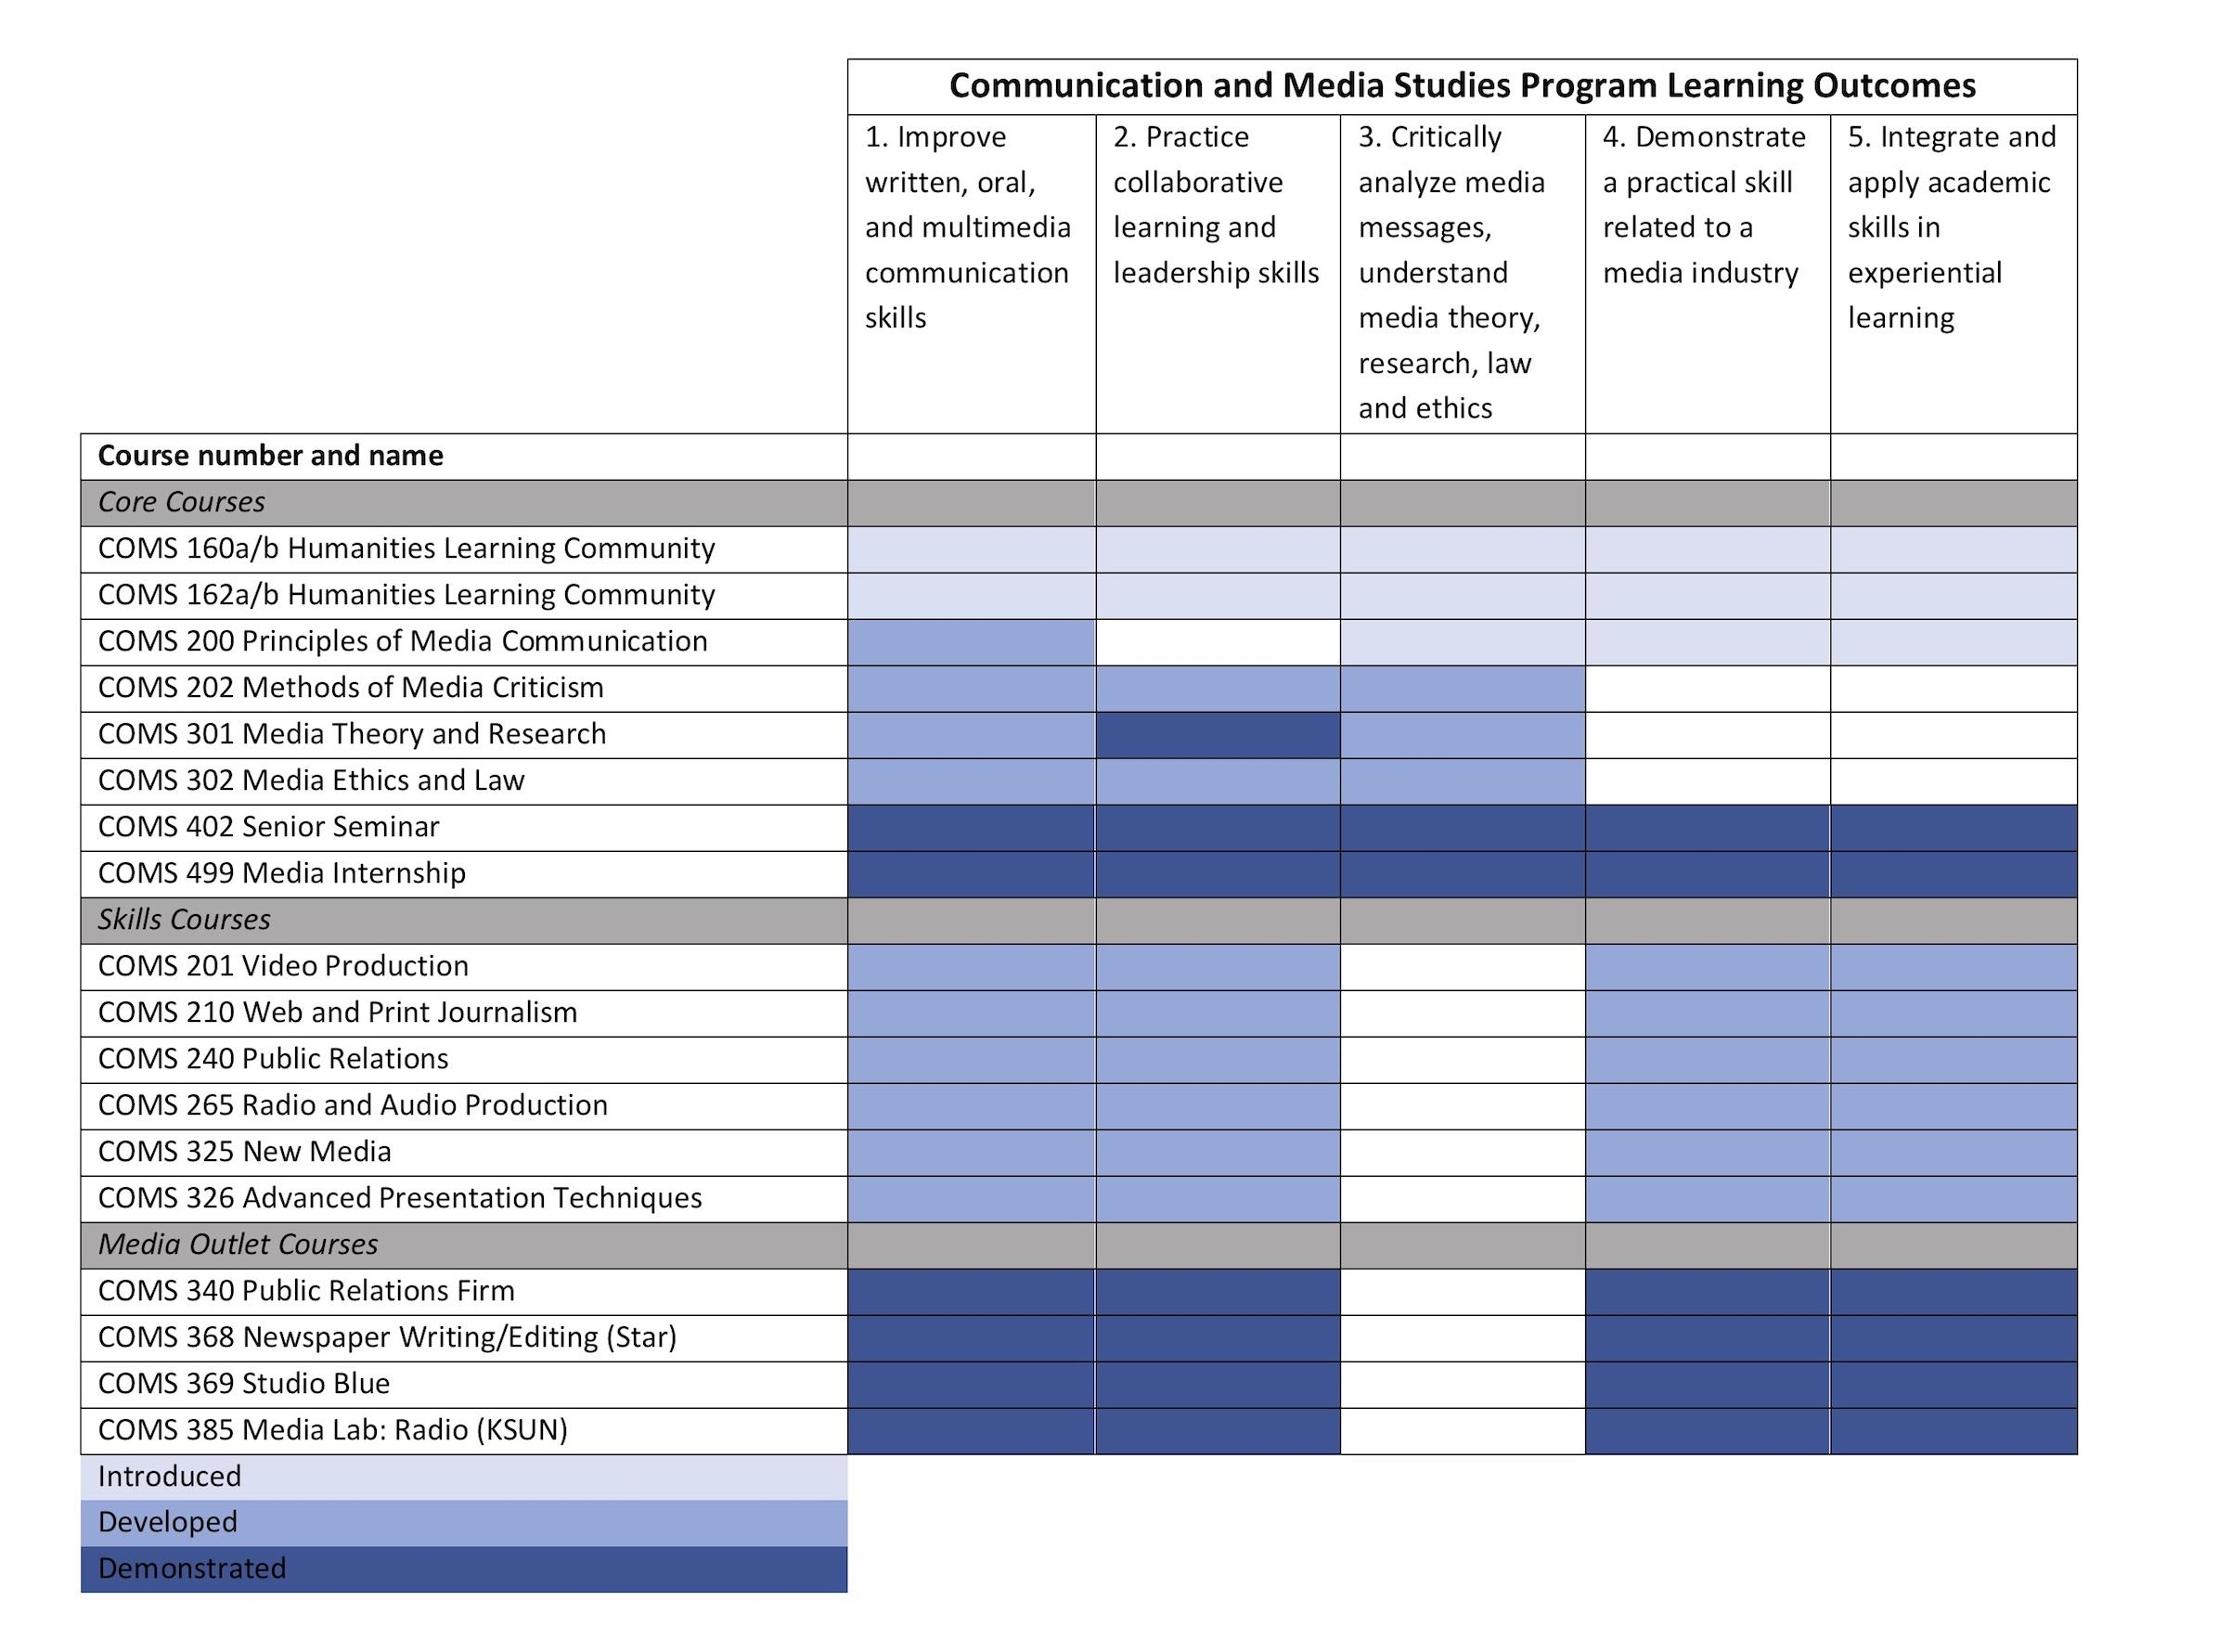

Slide 6
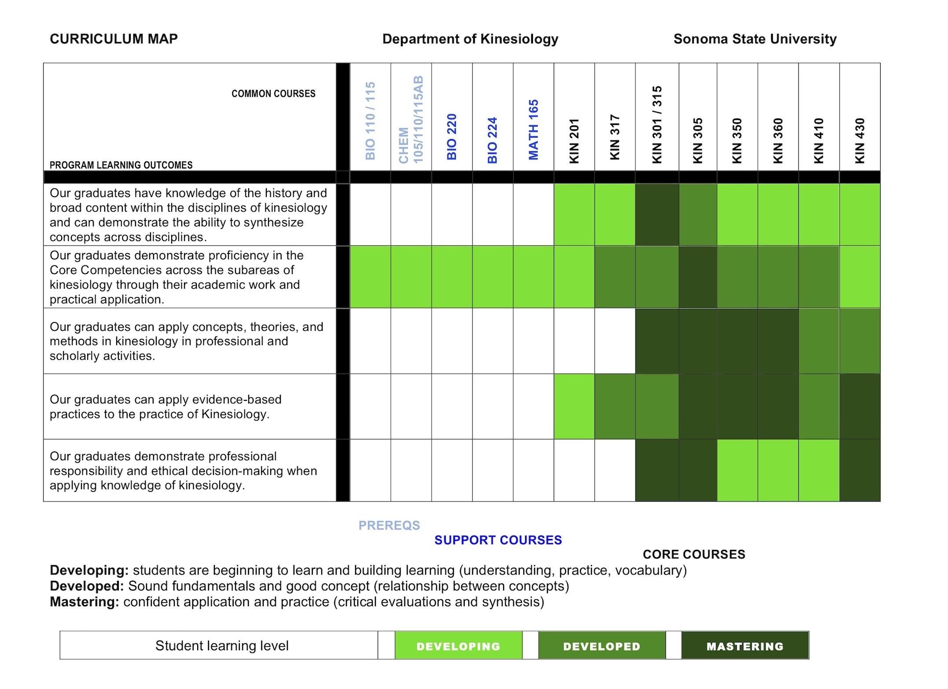
Notes:
‹#›

Slide 7
Program Review Process
Year One: Write Self Study and Complete External Review
Year Two: Shared Governance Review, Dean’s letter, UPRS Review, and Action Plan (MOU)

Slide 8
We Are Here to Help:
Resources and Support
Faculty workload should be negotiated with dean
External reviewers should be approved by Dean and AVP of Academic Affairs
  Approved reviewer will be contracted out of the Academic Programs office
PowerPoint , policy, self-study guide, and checklist available at Academic Programs webpage
Data required by program review template available on Tableau, CSU dashboards, and from Institutional Effectiveness
Support from Academic Programs, Center for Teaching and Educational Technology, and Institutional Effectiveness

Slide 9
Questions?
Stacey Bosick, Associate Vice President for Academic Affairs & Dean of Undergraduate and Graduate Studies: bosick@sonoma.edu
Heather Brown, Associate Vice President for Institutional Effectiveness: heather.brown@sonoma.edu
Nina Bardwell-Chanthalangsy, Academic Programs Operations Analyst: bardwellch@sonoma.edu
Notes:
‹#›

